Slide 1

HOUSE BROKER
House Rent Application Software
MD. RAKIBUL HASAN RAKIB
ID : UG02-59-22-002
MD. MUSTAFIZUR RAHMAN
ID : UG02-59-22-019

Slide 2
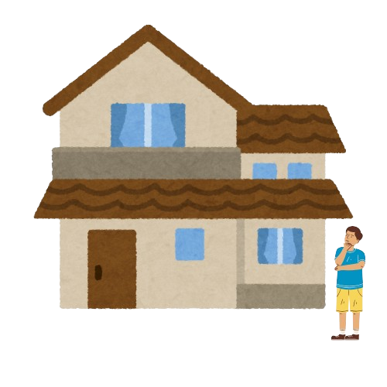
Description of Tropics
Tropics is an innovative, home rent application platform specifically made for individuals and families looking for rental homes. It provides a personalized search experience with bachelors, single women, small families and larger families that match their specific housing requirements.

Slide 3
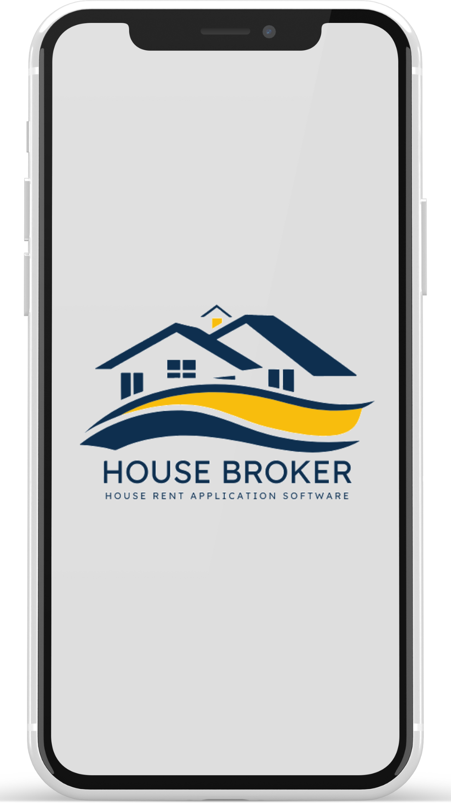
01
Features

Slide 4

Property Search
User Profiles•
Document Upload•
Application Tracking•
Communication Tools
Payment Methods

Slide 5
02
Stakeholder Identification

Slide 6

Tenants
Male/Femail Bachelors
Small/Large Families
Landlords or Property Owners
Real Estate Agents
System Admin

Slide 7
03
Functional Requirements

Slide 8

User Registration and Authentication
Property Search
Profile Management
Rental Application Submission
Payment Integration
Messaging System
Application Status Tracking
Help Center

Slide 9
04
Non-Functional Requirements

Slide 10

Usability
Performance
Scalability
Security
Reliability
Compatibility

Slide 11
05
COCOMO Model

Slide 12

Define the Project
Identify the Project Mode
Use Constants for Mode
Calculate Effort
Calculate Development Time

Slide 13
06
Use Case Diagram

Slide 14

System Management
Sequrity
Admin
Registration
Profile
Post
Rentor
Search
Landlord
List Property
Communication

Slide 15
07
Class Diagram

Slide 16
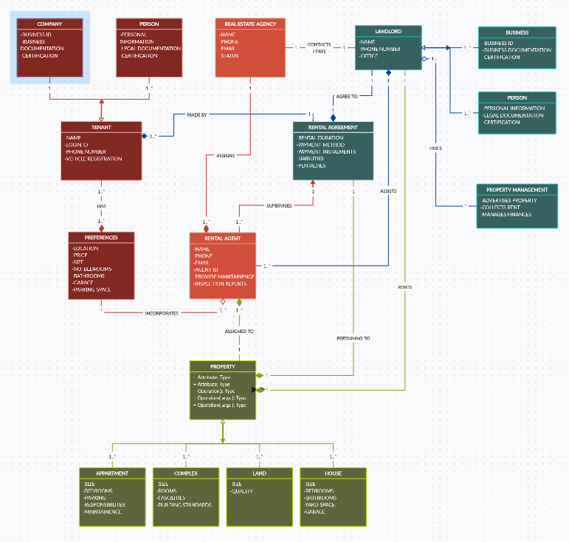

Slide 17
08
CRC Card

Slide 18
House
Responsibilities: Store house information (address, size, number of rooms, amenities, etc.) Know its availability status. Calculate rent amount. | Collaborators: RentalAgreement Tenant
Tenant
Responsibilities: Store tenant information (name, contact details, etc.) Rent a house Pay rent | Collaborators: RentalAgreement Payment

Slide 19
Rental Agreement
Responsibilities: Define the terms of a rental agreement (start date, end date, rent amount, etc.) Track payment history Handle lease renewals or terminations | Collaborators: House Tenant
Admin
Responsibilities: Add, edit, and remove houses Manage tenant accounts Generate reports | Collaborators: House Tenant RentalAgreement

Slide 20
09
Prototyping

Slide 21
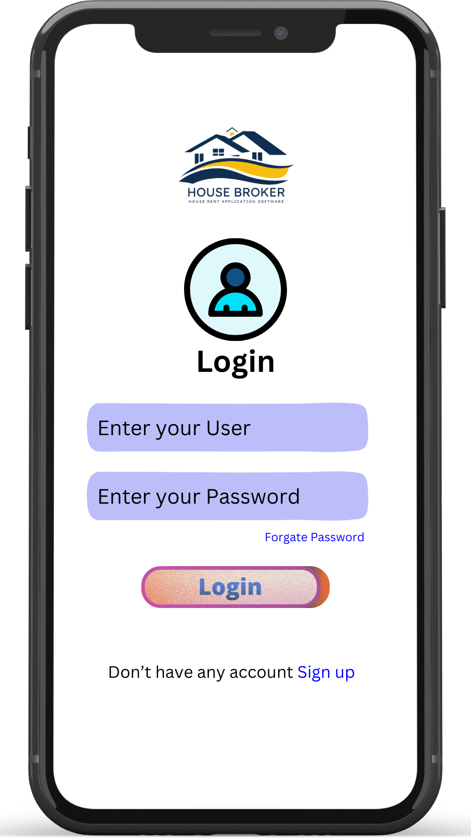
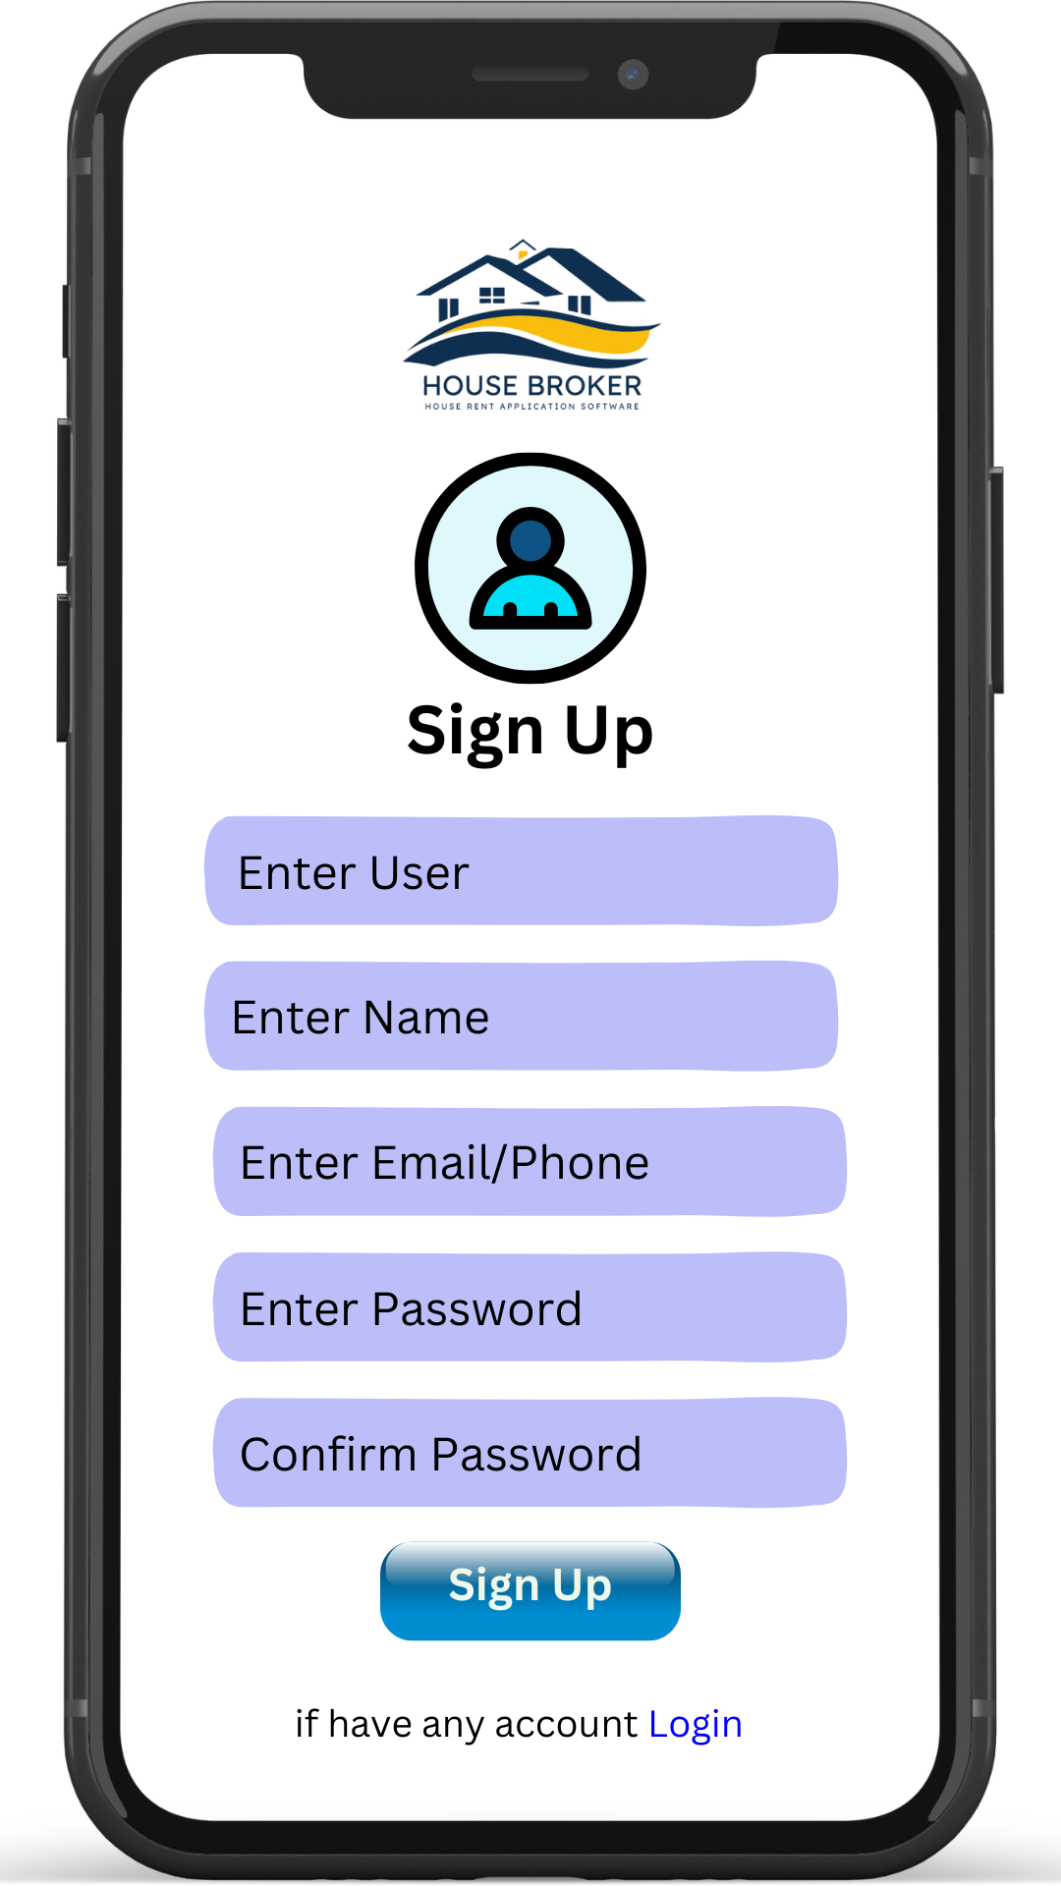

Slide 22
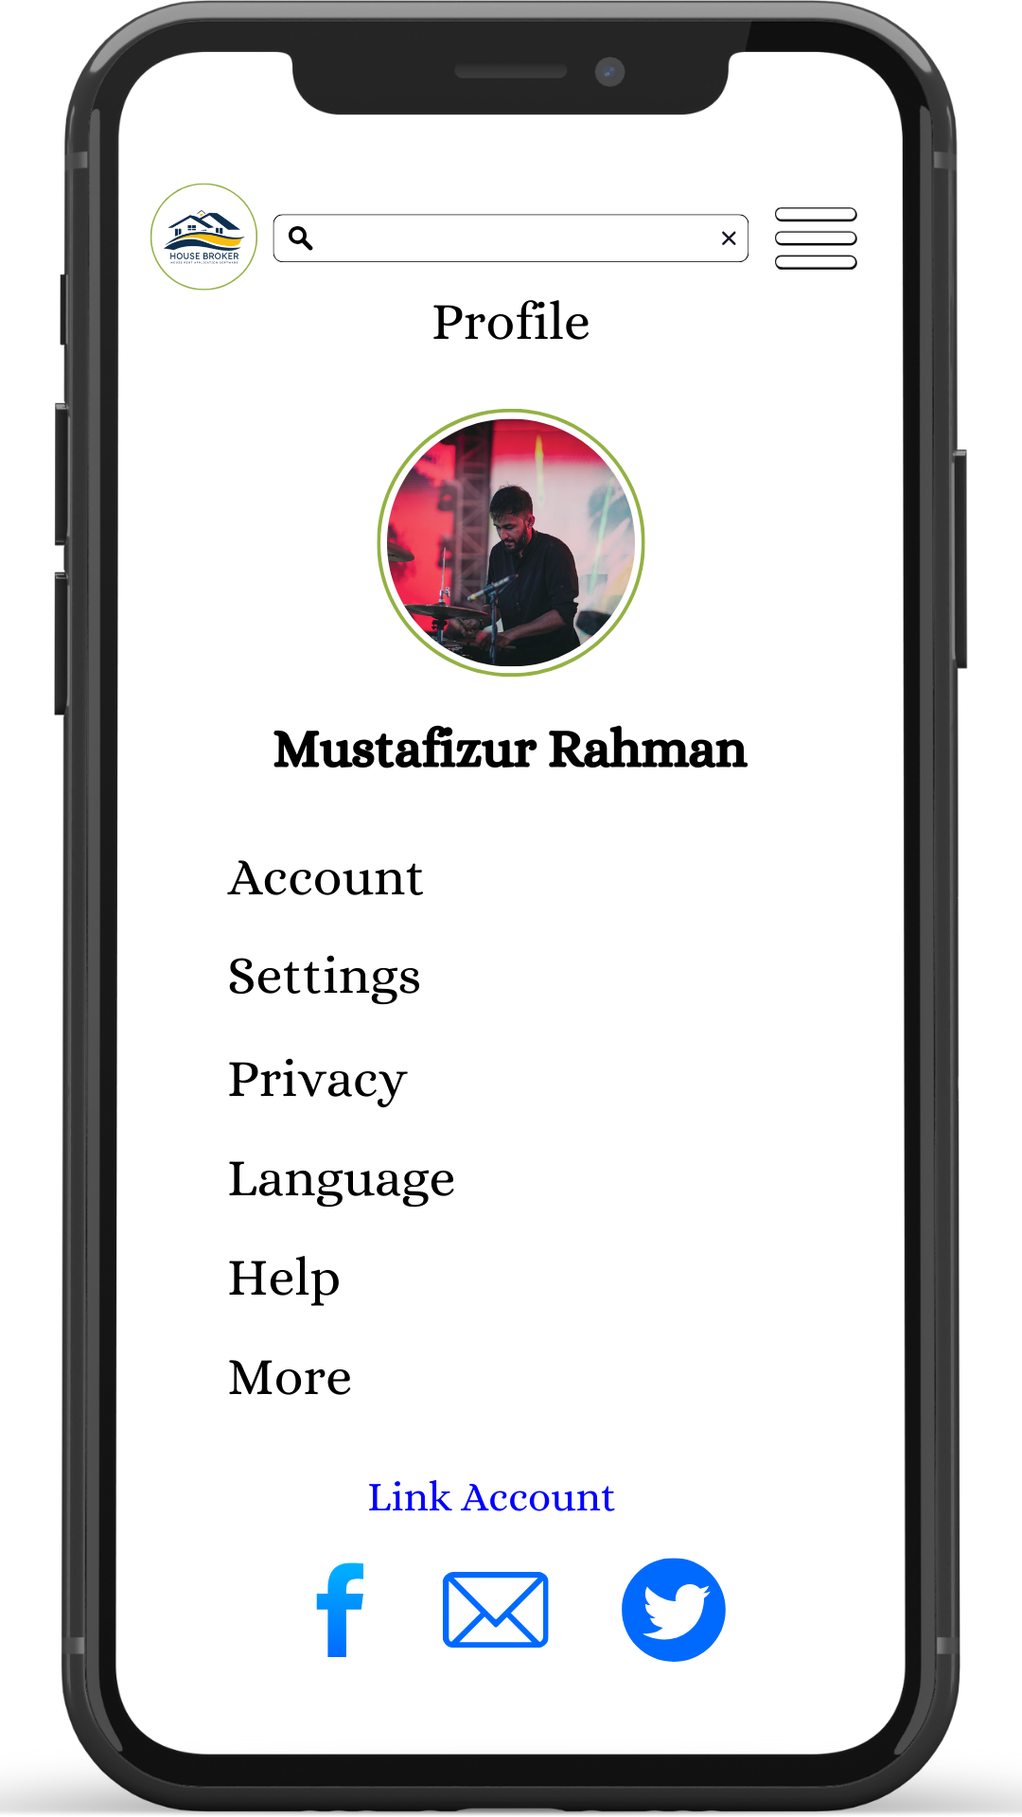
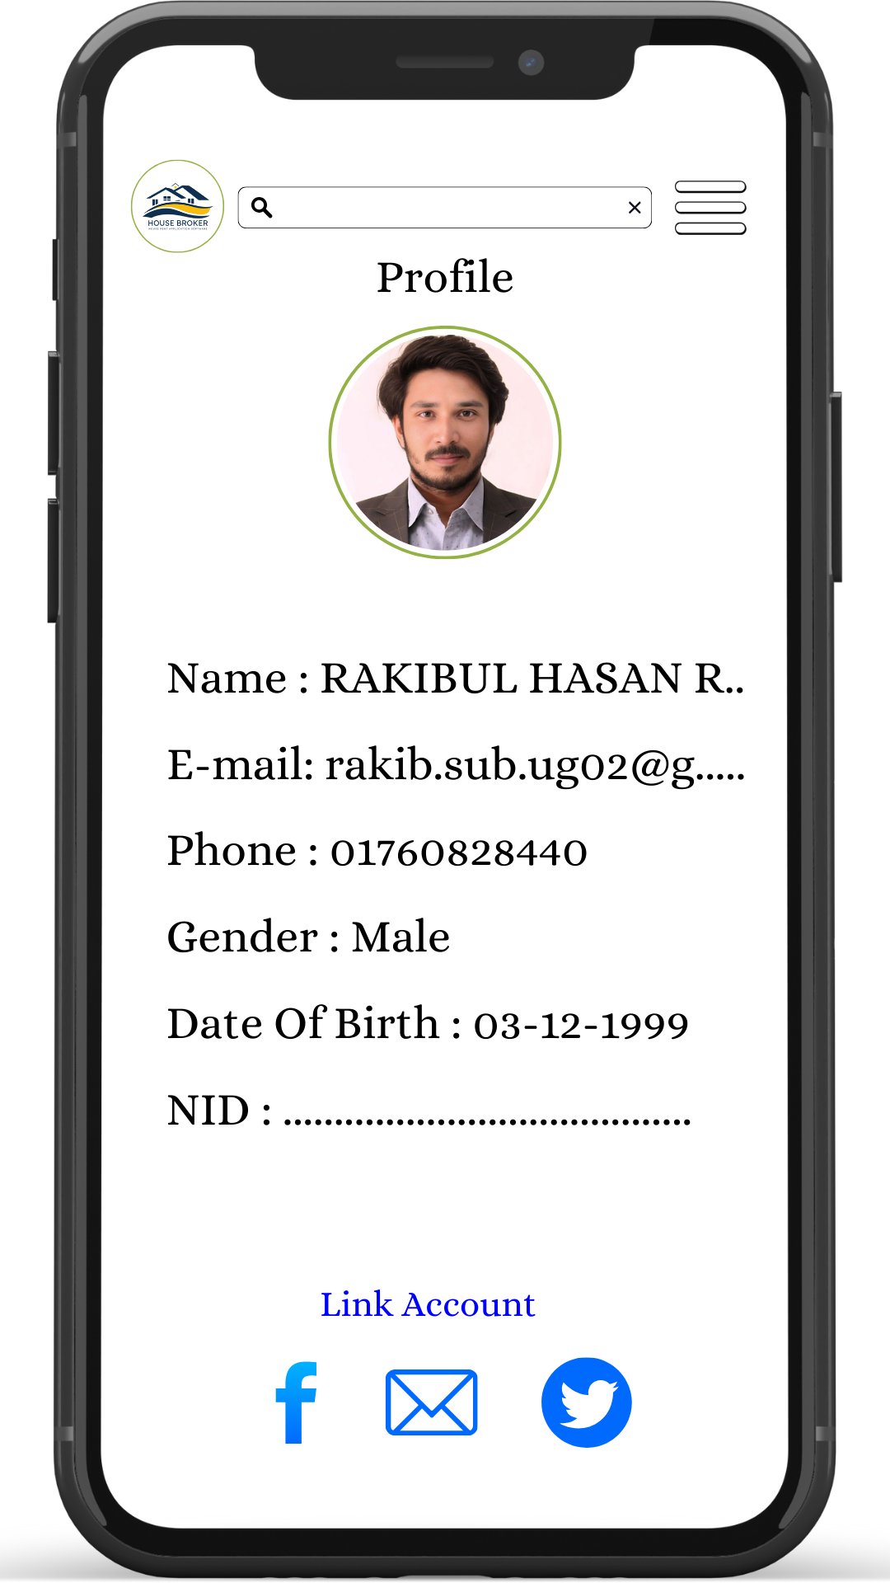

Slide 23
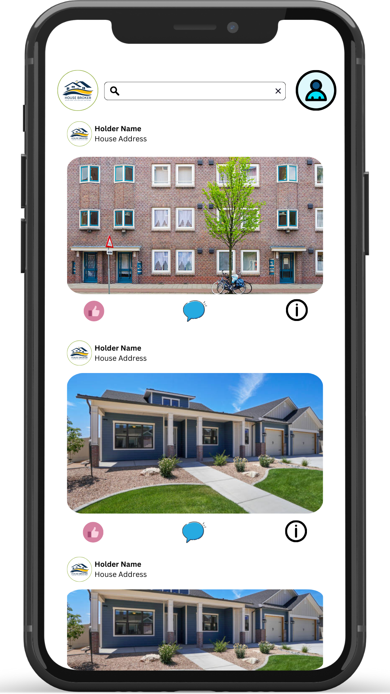
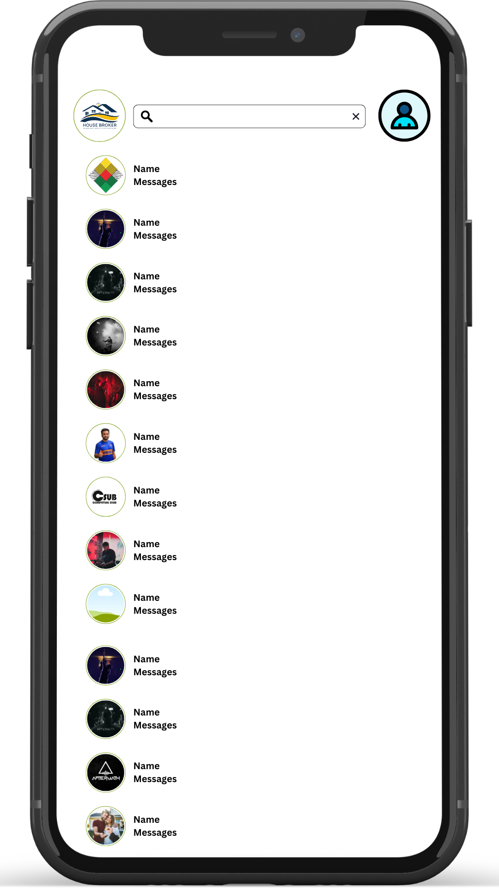

Slide 24
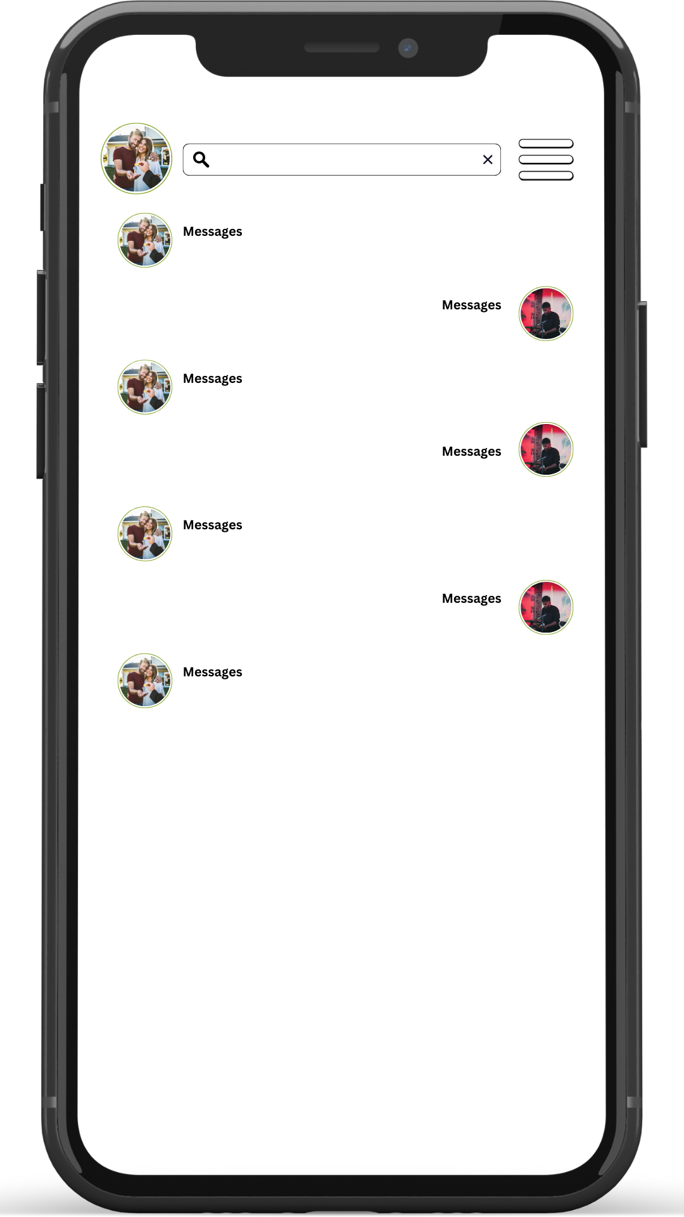

Slide 25
10
Testing

Slide 26
Unit Testing
White Box Testing
Black Box Testing
Security Testing

Slide 27
THANK YOU

